Slide 1
Virtual Communications Lab
“Inside Internal Communications”
Robert Hornsby, Asso Vice Pres, Internal Communications
Scott Miller, Associate Director, Strategic Communications, CUIT
Cassandra Nathan, Associate Director, Internal Communications
November 12, 2021

Slide 2
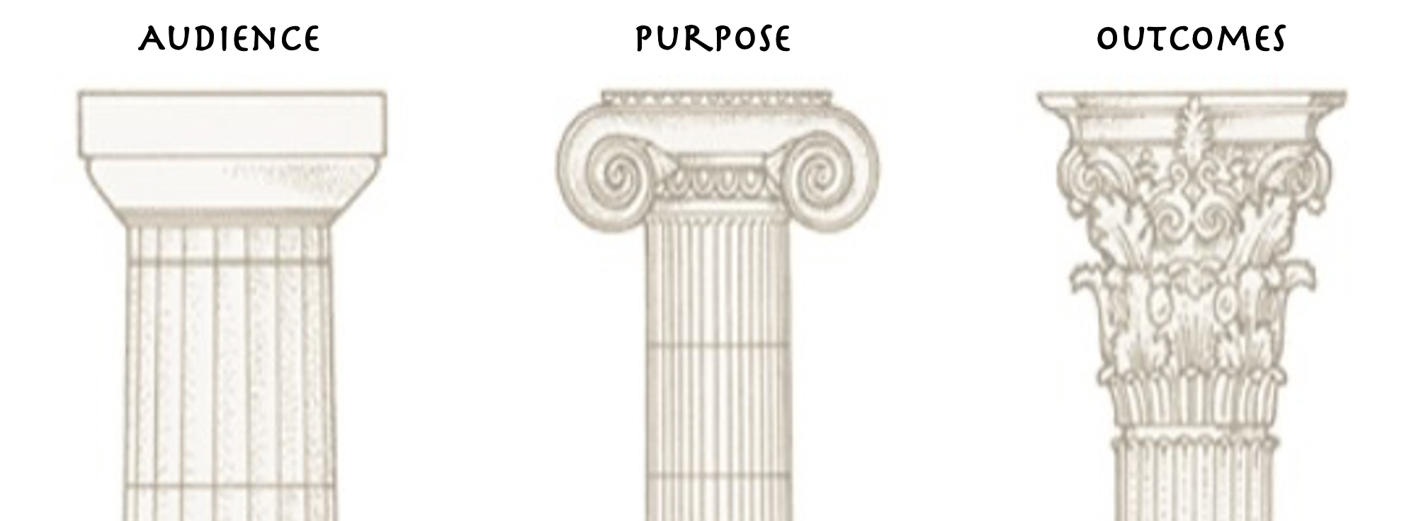
The Basics -- Three pillars of Communications:
Audience -- To whom are you communicating?
Purpose – Why are you communicating -- serving what goal?
Outcomes – After communicating, what impact do you seek?

Slide 3
Benefits of Good Internal Communications:
Improved employee engagement – employees feel valued and that their feedback is appreciated; greater opportunities for innovation.
Increased employee productivity – reduces lost work time searching for answers.
Reduces employee turnover – greater access to development opportunities, as well as show and develop leadership.
Stabilizes company culture – creates a sense of shared purpose.

Slide 4
Overview -- Internal Communications at Columbia:
Primary audiences are the faculty, researchers and staff.
We help produce and deliver messages on behalf of University management.
We advise and facilitate projects for offices addressing the entire University community.
We seek to develop better skills among University communicators.
We judge impact by evaluating engagement.
Our primary concerns are:
How to best engage with those audiences.
What we talk about.
How we talk to ourselves.

Slide 5
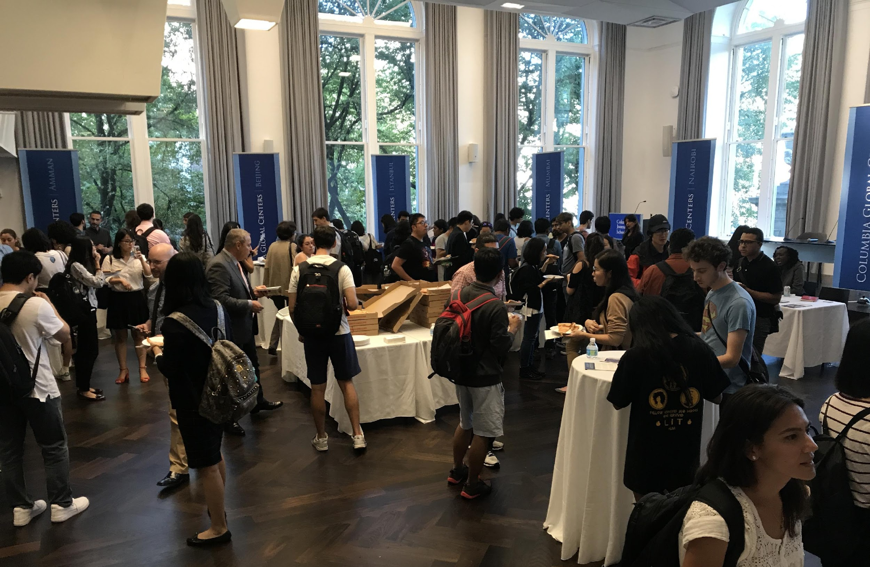
Overview -- Internal Communications at Columbia:
What about the students?
We collaborate with various offices on student communications:
University Life
Deans of Students
International Students & Scholars Office (ISSO)
Columbia Global Centers, and others
Global Centers hosted an information session…with free pizza.

Slide 6
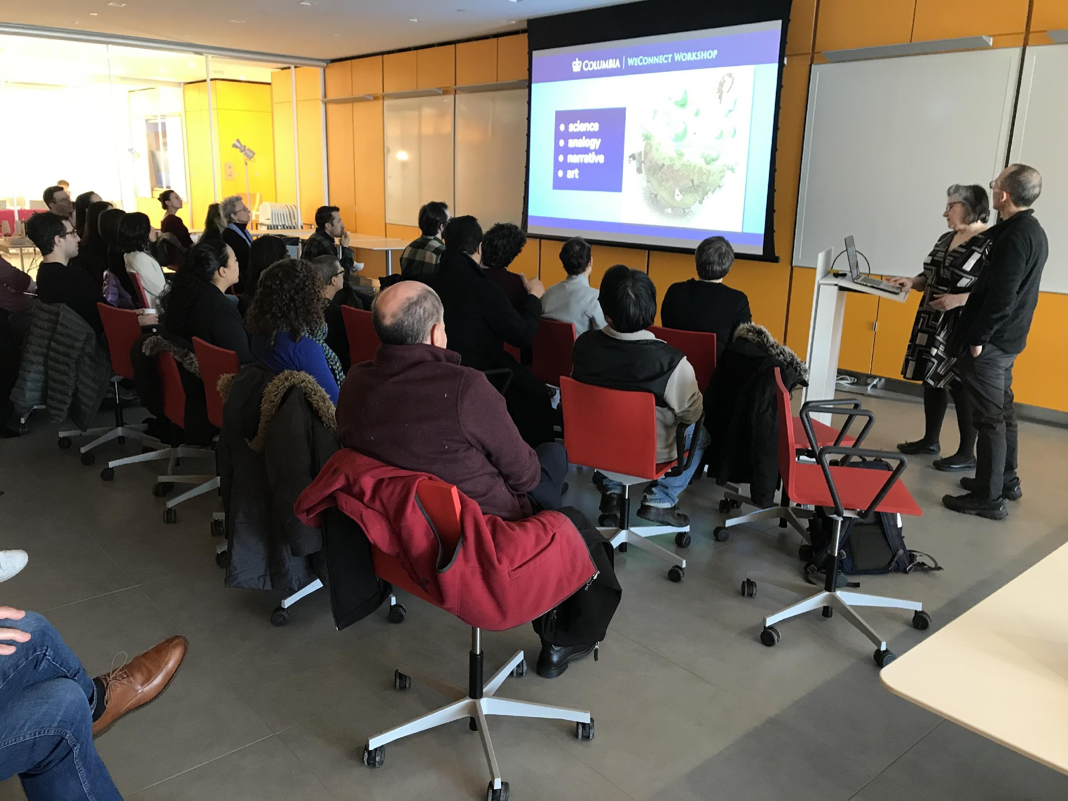
Internal Communications programs:
WeConnect:
A collective of more than 370 Columbia staff who either hold a communications job title or
fulfill a communications role in their school, dept, institute, center or unit.
Professional Development courses:
  NEW Virtual Comms Lab
  Strategic Communications Planning course
  Visualizing Science (for both faculty & staff)
  The first Visualizing Science workshop, live.

Slide 7
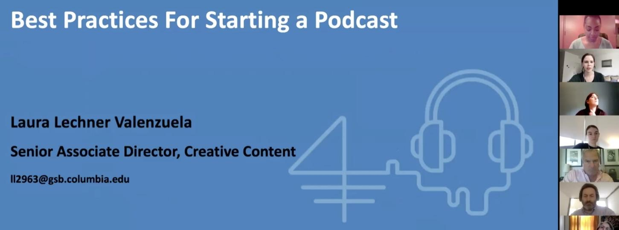
Internal Communications programs (cont.):
WeConnect topical workshops:
  Podcasts
  Annual Reports
Pre-Covid live workshops:
  Social Media
  Video production / ESPN
  Opinion Editorials & LinkedIn
  “Research Matters”
(Communicating Science)

Slide 8

Our network includes:
Internal Communications working group – advisory board
Digital Display group – managers of on-campus lobby monitors
Emergency Management Operations Team (“EMOT”)
Campus Lightbox group – “owners” of display boxes along College Walk
Campus Access group – film project review
Rankings working
Covid Projects:
Virtual forum Zoom series for staff
Covid Safety Coordinators group
Coordination of physical and digital
signage with Columbia Creative

Slide 9
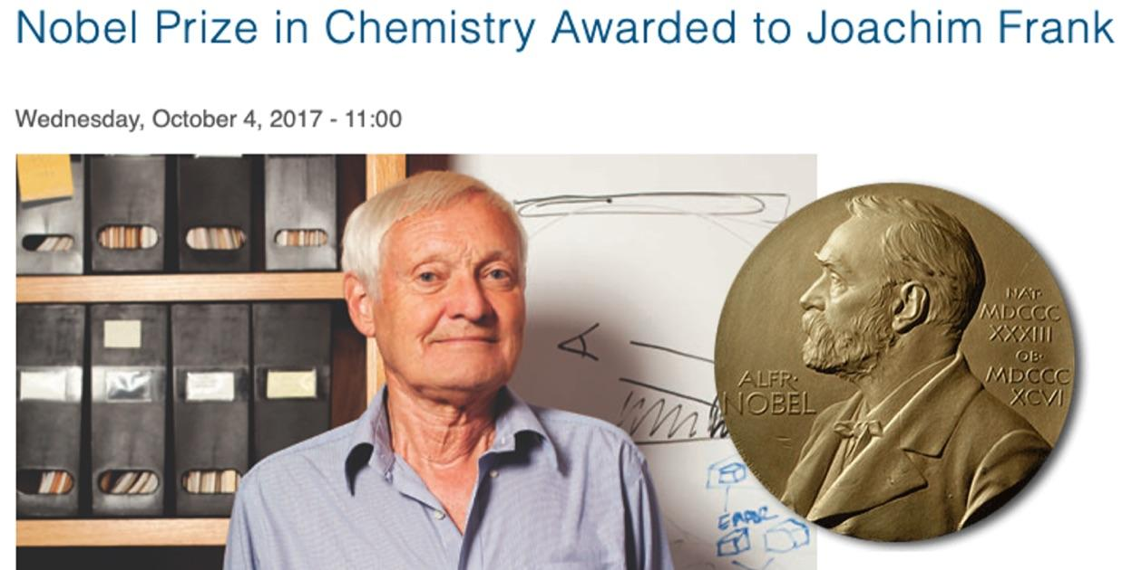
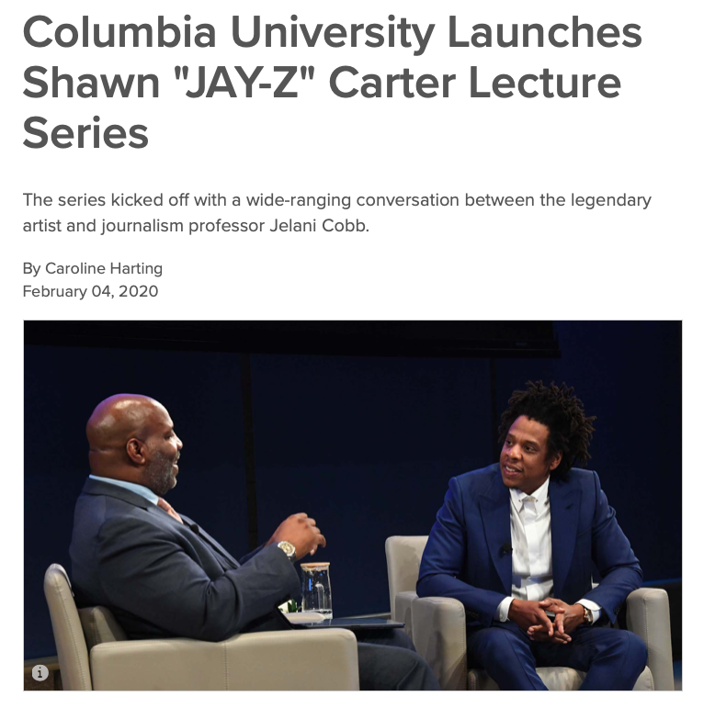
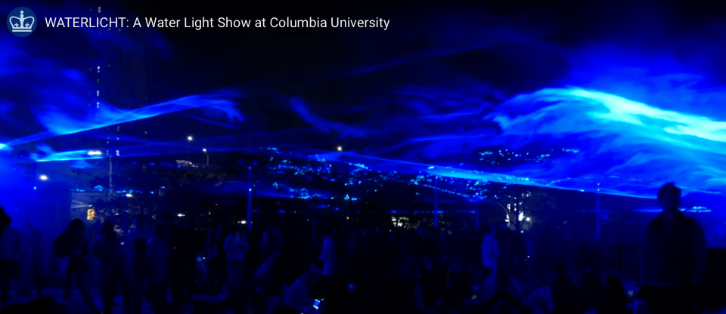

Internal Communications programs (cont.):
Special Events & other projects:
Nobel Prize announcements
Waterlicht
“Year of the Core” 100th Annivesary
The Shawn “Jay-Z” Carter Lecture Series

Slide 10
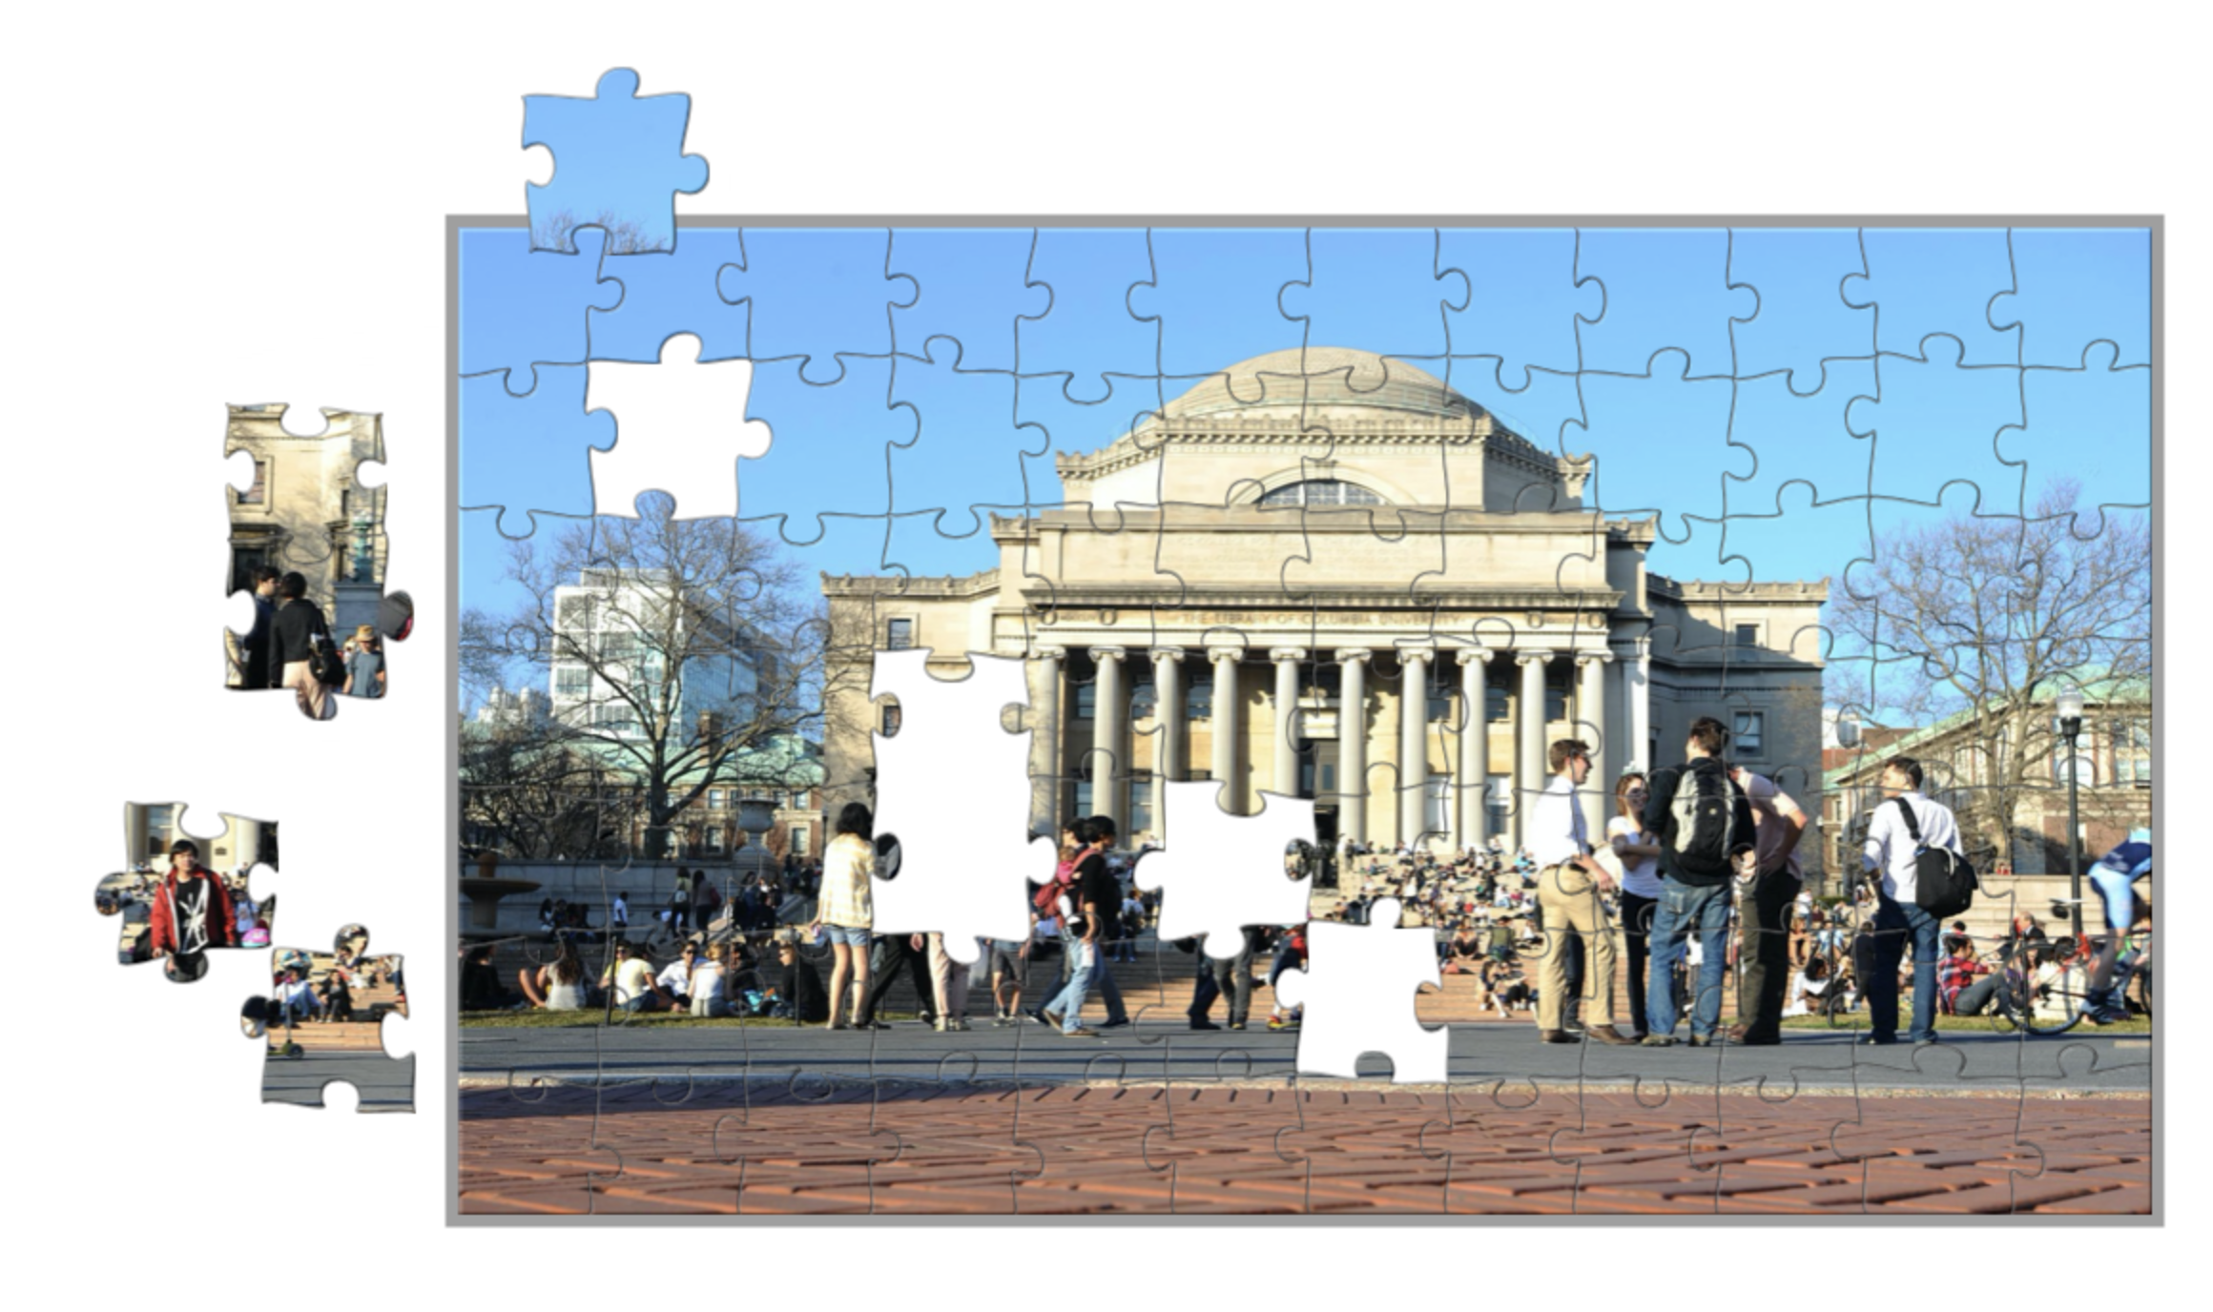
Additional Sources of Internal Communications:
Human Resources
Provost – to faculty and researchers
Columbia Health to all community
CUIT - Enterprise security and
service-related updates
Others?

Slide 11

Primary Channels:
Digital:
  Email & enewsletters
  Webpage
  File sharing platforms (Google Drive, LabArchives)
  Collaboration software (i.e., Slack, RingCentral,
  Sharepoint, etc.)
Social media – Facebook, Twitter, Instagram, etc.
Physical world – print, signage
Person-to-person – Live events, actions, briefings, town halls, brown bags, etc.
Scott Miller: “Everything internal is now external as well.”

Slide 12
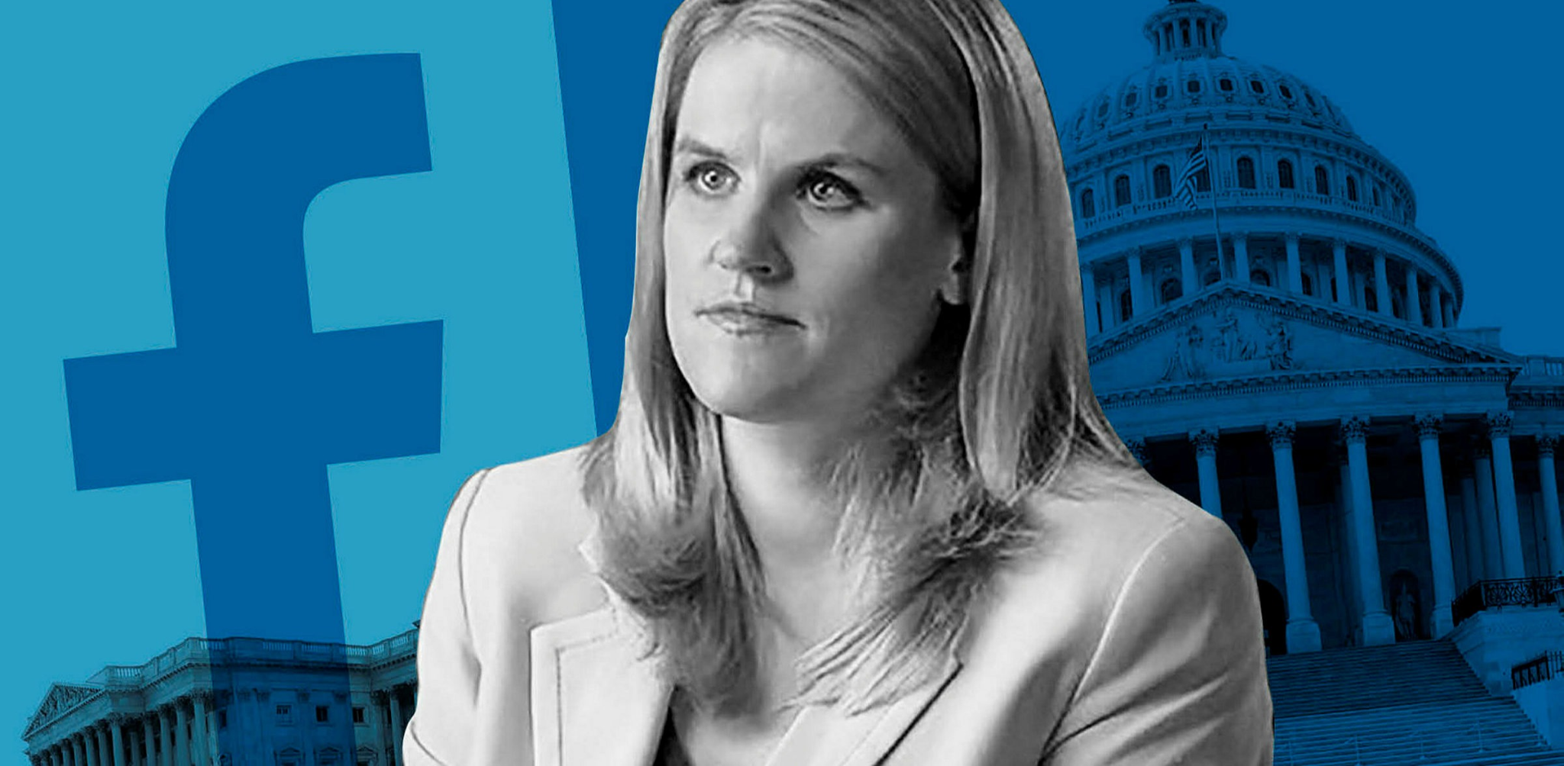
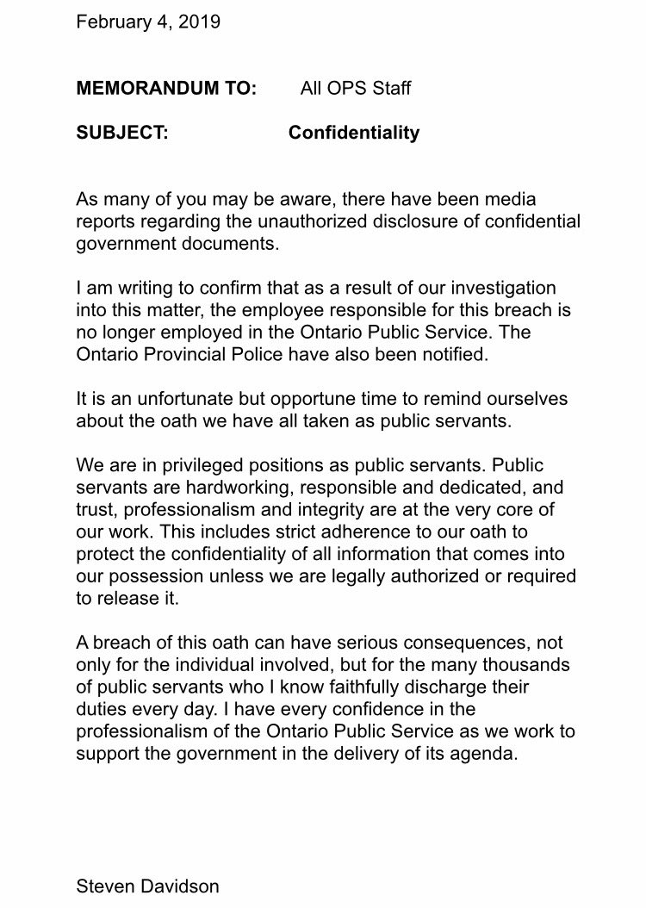
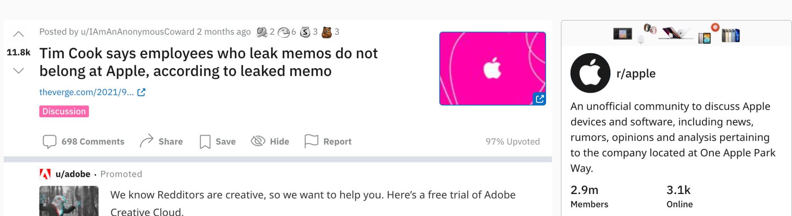
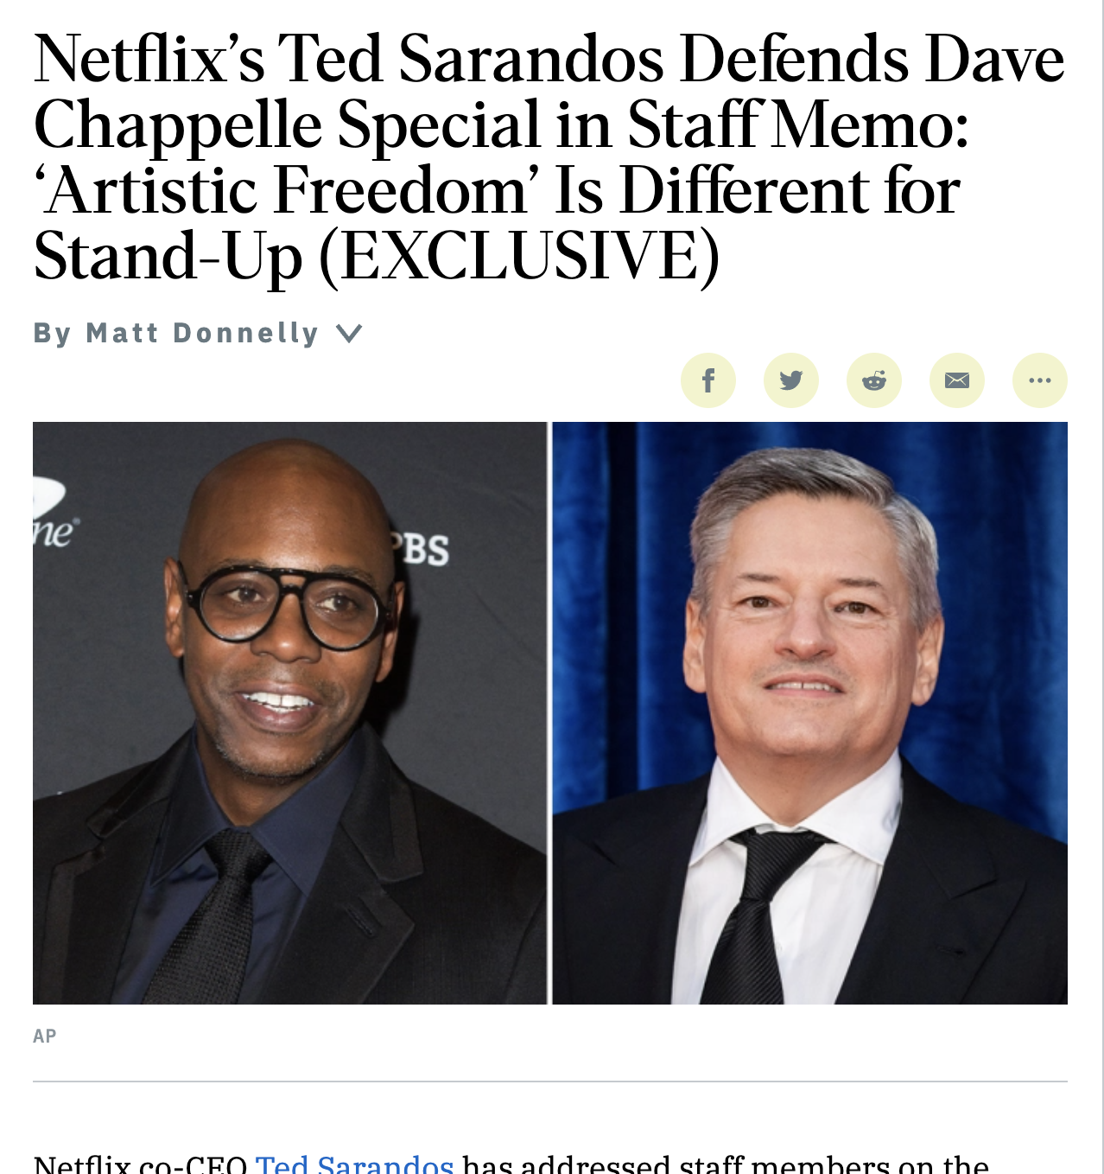
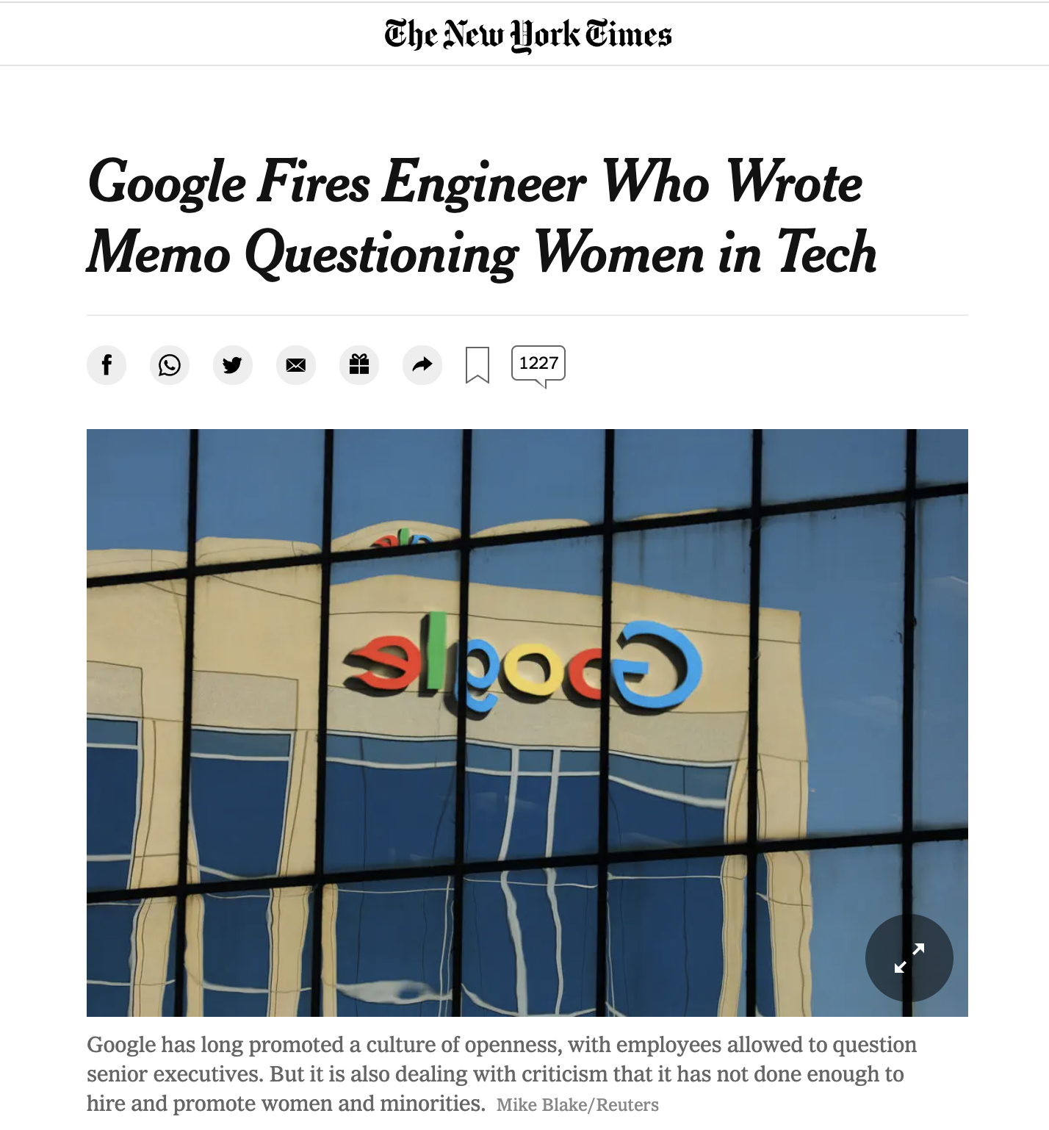
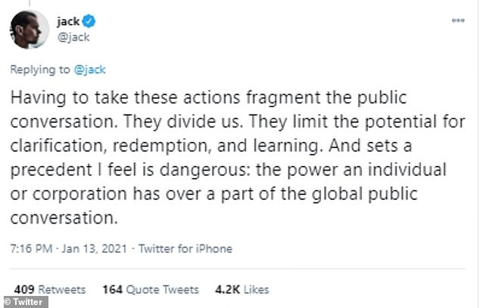
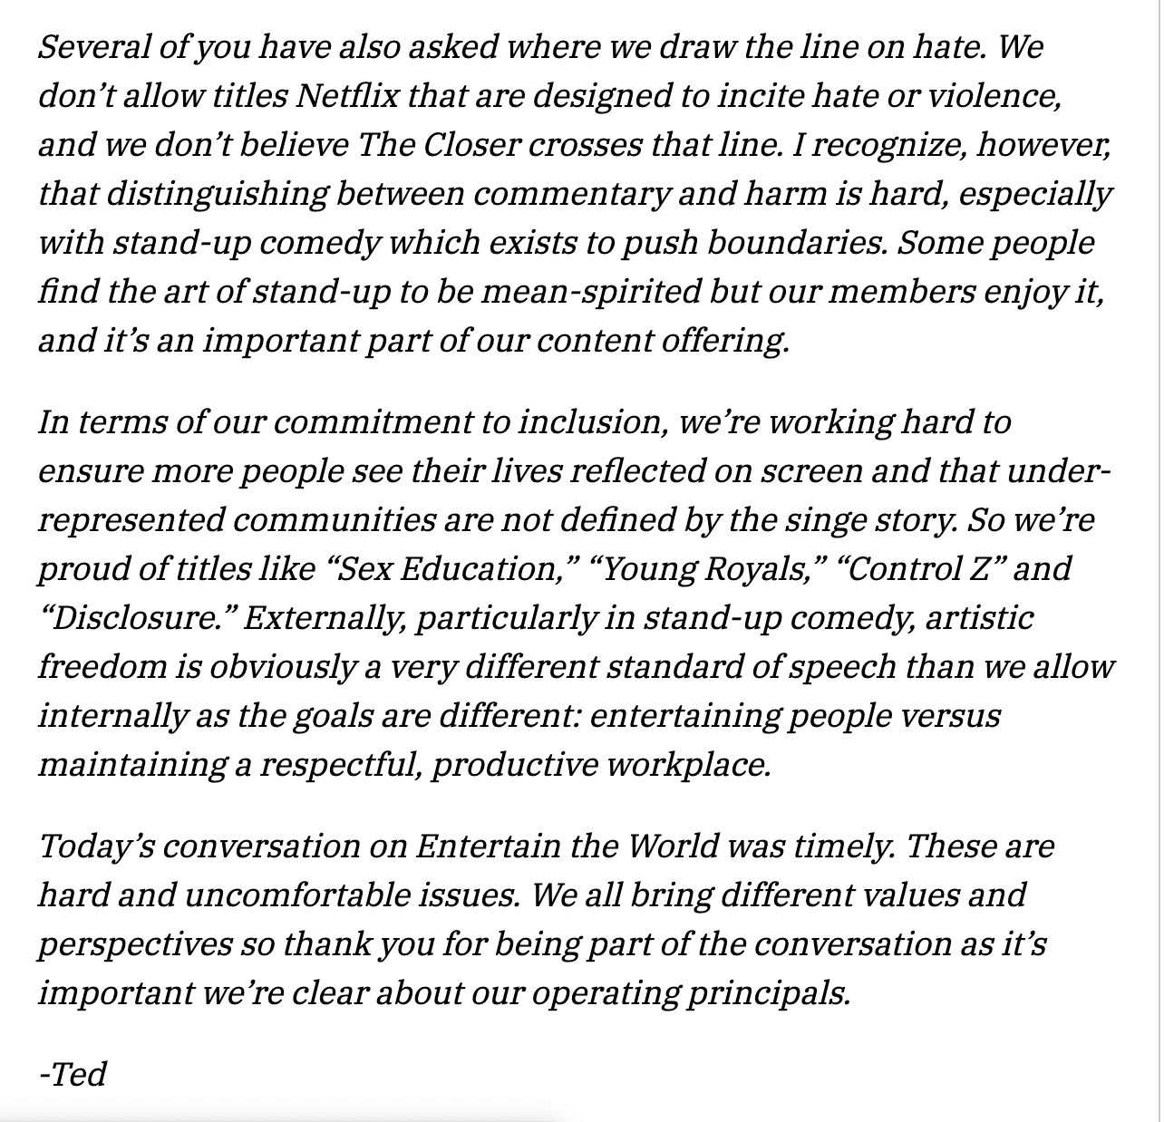
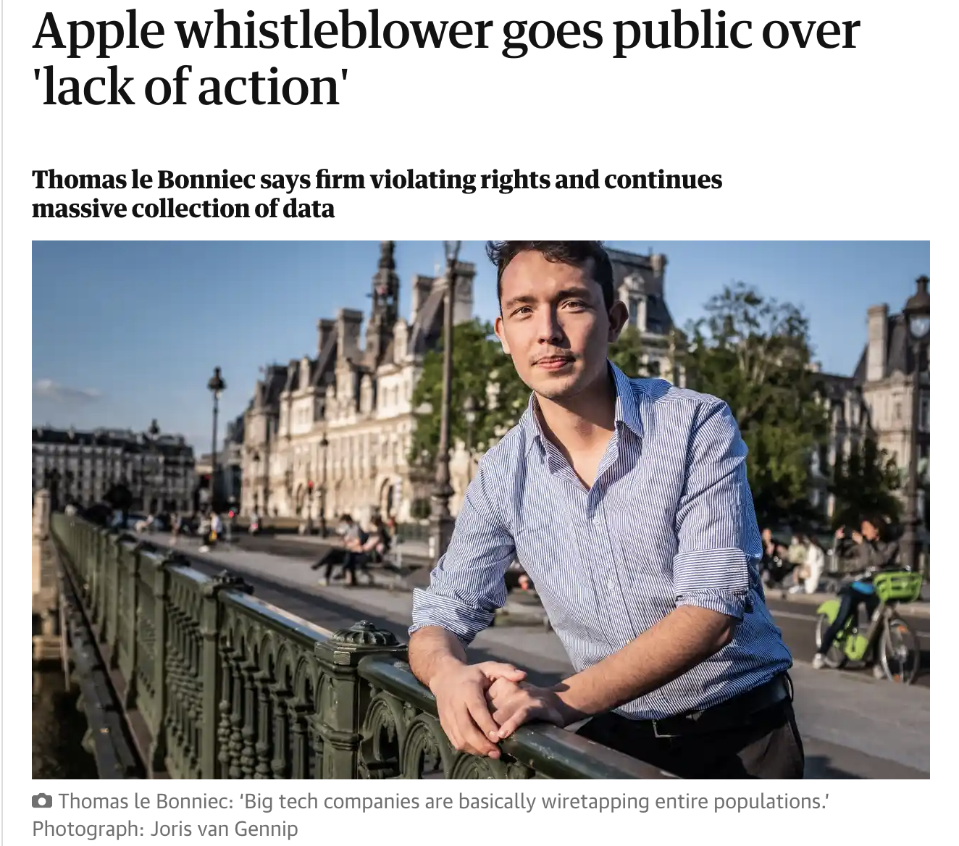
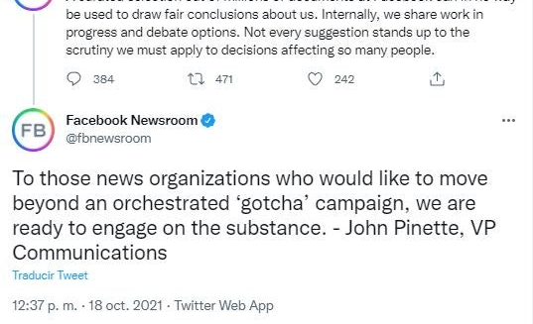
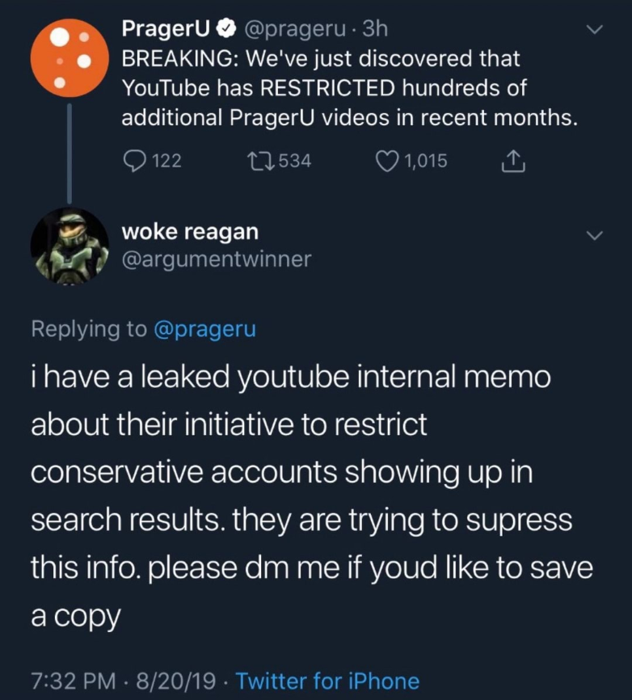


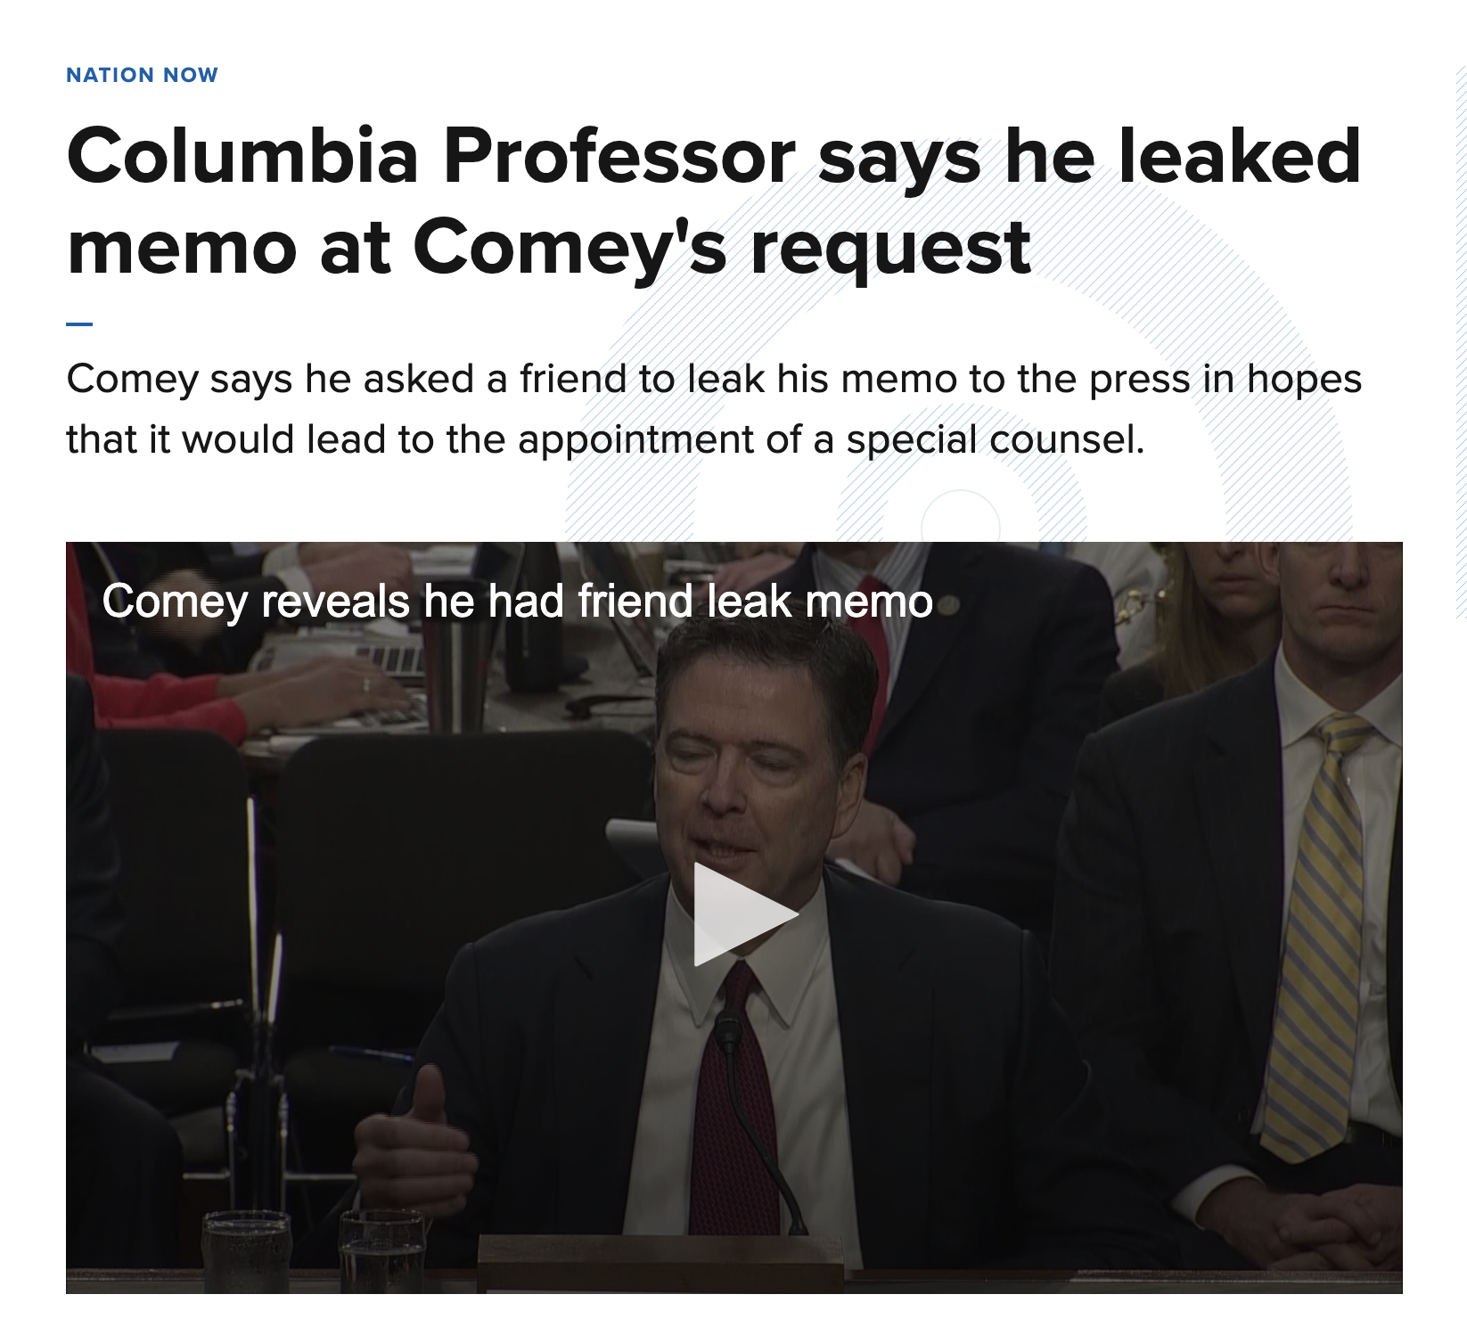
Internal is the new external
Notes:
THE OLD AXIOM: IF YOU WOULDN’T WANT YOUR GRANDMOTHER TO READ IT...
SOME GOOD EXAMPLES...
Google
Apple
Facebook (Meta)
Even a big’ole fancy Ivy League in NYC… Yep, Columbia

Slide 13

Best practices for Internal Communications:
Make it:
Clear and simple
Complete (but keep it short**)
Compelling
Visual
Regular (but not too often)
Also:
Make “Call-to-action” crystal clear
Make deadlines (and consequences) clear
** to the extent the content and situation allows

Slide 14
Things to Avoid:
Jargon (obscures meaning)
Dependence upon or overuse of acronyms
Too-frequent messages (creates fatigue, audience tunes out)
“Frankenstein” communications with competing information “bolted on”
Digital-only approach that ignores non-digital staff

Slide 15
Discussion topics:
What is “engagement?”
What creates meaningful engagement?
What is success with Internal Communications?
How do you measure success?
Question and answer segment next…

